Slide 1

Nerdism
Month: October
Year: 2022
Proof for factorial of zero and negative integers
Alioune

Slide 2


Slide 3
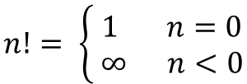
Required to prove:
$$n!= \left\{\begin{aligned} 1 n=0 \\ ∞ n<0\end{aligned}\right.$$
Proof:
By definition:
$$n!=n×\left(n−1\right)×\left(n−2\right)×…×2×1 where n∈ℕ$$
Since $n∈ℕ$, then $\left(n+1\right)!$ is possible
Then by definition:
$$\left(n+1\right)!=(n+1)×n×\left(n−1\right)×\left(n−2\right)×…×2×1$$

Slide 4
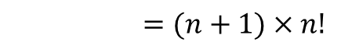
Required to prove:
$$n!= \left\{\begin{aligned} 1 n=0 \\ ∞ n<0\end{aligned}\right.$$
Proof:
By definition:
$$n!=n×\left(n−1\right)×\left(n−2\right)×…×2×1 where n∈ℕ$$
Since $n∈ℕ$, then $\left(n+1\right)!$ is possible
Then by definition:
$$\left(n+1\right)!=(n+1)×n×\left(n−1\right)×\left(n−2\right)×…×2×1$$
$=(n+1)×n!$

Slide 5
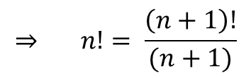
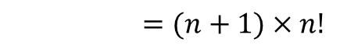
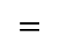
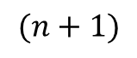
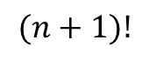
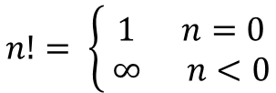
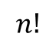
Required to prove:
$$n!= \left\{\begin{aligned} 1 n=0 \\ ∞ n<0\end{aligned}\right.$$
Proof:
By definition:
$$n!=n×\left(n−1\right)×\left(n−2\right)×…×2×1 where n∈ℕ$$
Since $n∈ℕ$, then $\left(n+1\right)!$ is possible
Then by definition:
$$(n+1)!$$
$$\left(n+1\right)!=(n+1)×n×\left(n−1\right)×\left(n−2\right)×…×2×1$$
$=(n+1)×n!$
$$=$$
$$(n+1)$$
$$n!$$
🤗
$$⇒ n!= \frac{\left(n+1\right)!}{(n+1)}$$

Slide 6

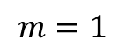
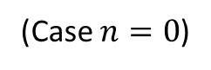



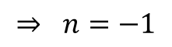
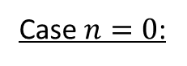
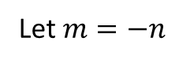
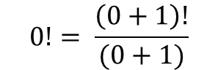

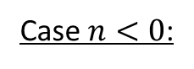
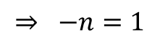

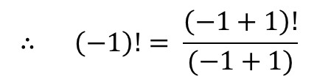
Case $n=0$:
$$0!= \frac{\left(0+1\right)!}{(0+1)}$$
$$= \frac{1!}{1}$$
$$= \frac{1}{1}$$
easy 🤗
$$=1$$
Case $n<0$:
Let $m=−n$
$$⇒ m!=m×\left(m−1\right)×\left(m−2\right)×…×2×1$$
$$m=1$$
$$⇒ −n=1$$
$$⇒ n=−1$$
$$∴ \left(−1\right)!= \frac{\left(−1+1\right)!}{(−1+1)}$$
$$= \frac{0!}{0}$$
well, technically…you know what I mean 😊
$$= \frac{1}{0}$$
(Case $n=0$)
$$=∞$$

Slide 7
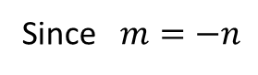
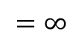
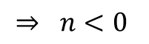
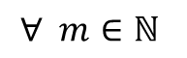

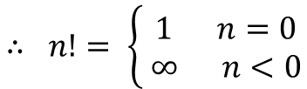
$$∴ m!=m×\left(m−1\right)×\left(m−2\right)×…×2×∞$$
$$=∞$$
Since $m=−n$
$$⇒ n<0$$
$$∀ m∈ℕ$$
$$∴ n!= \left\{\begin{aligned} 1 n=0 \\ ∞ n<0\end{aligned}\right.$$
$$∎$$

Slide 8


